Slide 1
Udacity self driving car Engineer nanodegree program Chapter1- Computer Vision
Document compiled by: Poluri Nikhil Koundinya
SENSOR AND CAMERA CALIBRATION

Slide 2
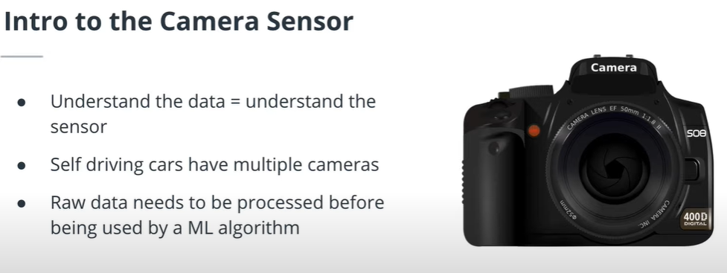
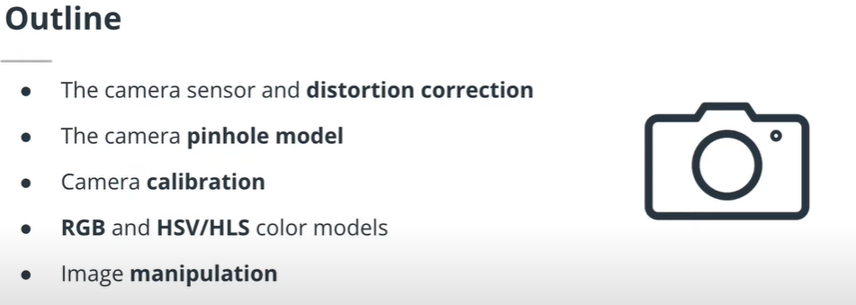
Intro to the Camera Sensor
DL basically uses digital Images. So, we better know about the sensor that captures the data.
Deriver less cars use a lot of cameras. The raw data which we get from cameras needs to be processed. We will see how to process and manipulate digital images.
The camera sensor and its distortion effect
The camera pinhole model
Camera calibration
RGB and other color systems
Image manipulation in Python

Slide 3
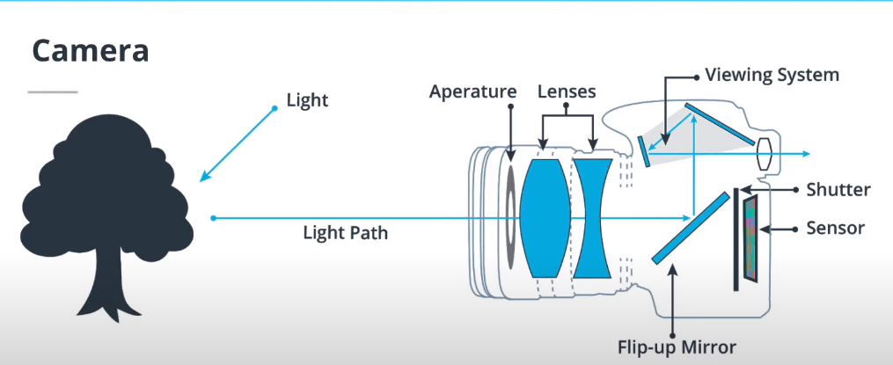
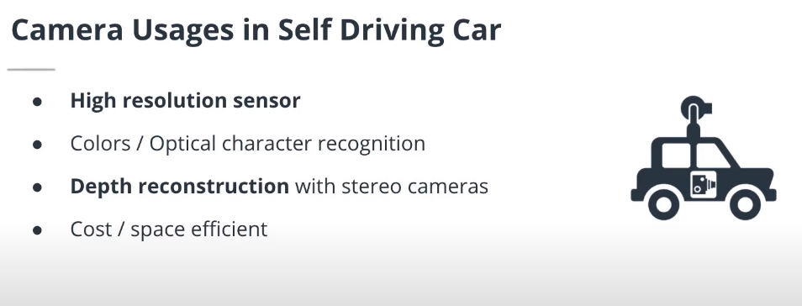
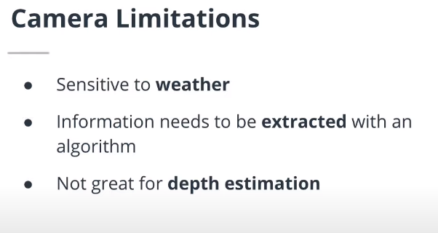
How does human vision works?
Human eye captures light that is reflected from the objects. Receptors inside our eyes convert the light into electrical signals and they are then transmitted to the brain. The brain transforms the messages into the images we see. A camera works differently.
Working of a camera
It captures and focusses the light on lenses that are placed in front of digital sensors. Depending on the model, a camera can have one or more lenses. The light signal is then received by digital sensor that captures it in digital format. There are many formats in which the diogital images can be saved such as JPEG and PNG.

Slide 4
Cameras are optical instruments capturing the light intensity on a digital image. The most important characteristics of a camera for a ML engineer are the following:
Resolution: Number of pixels the image captured by the camera is made of (usually described in mega pixels).
Aperture: size of the opening where the light enters the camera. Controls the amount of light received by the sensor.
Shutter speed: duration that the sensor is exposed to the light. Also controls the amount of light by the sensor.
Focal length / field of view: this parameter controls the angle of view of the image.
Most often camera is combined with RADAR or LIDAR to tackle its shortcomings.

Slide 5
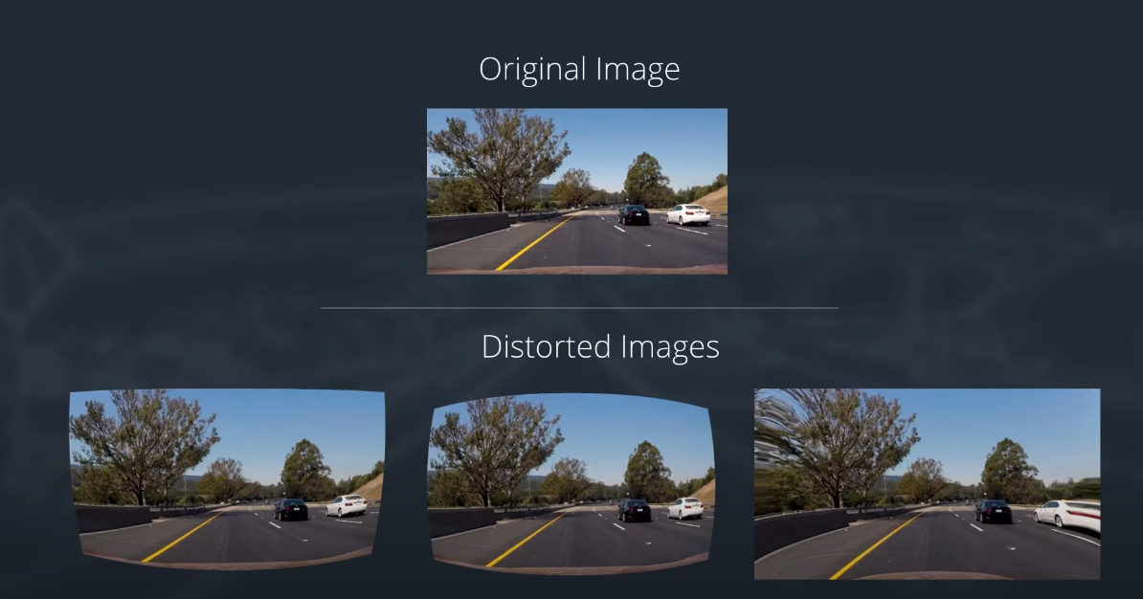
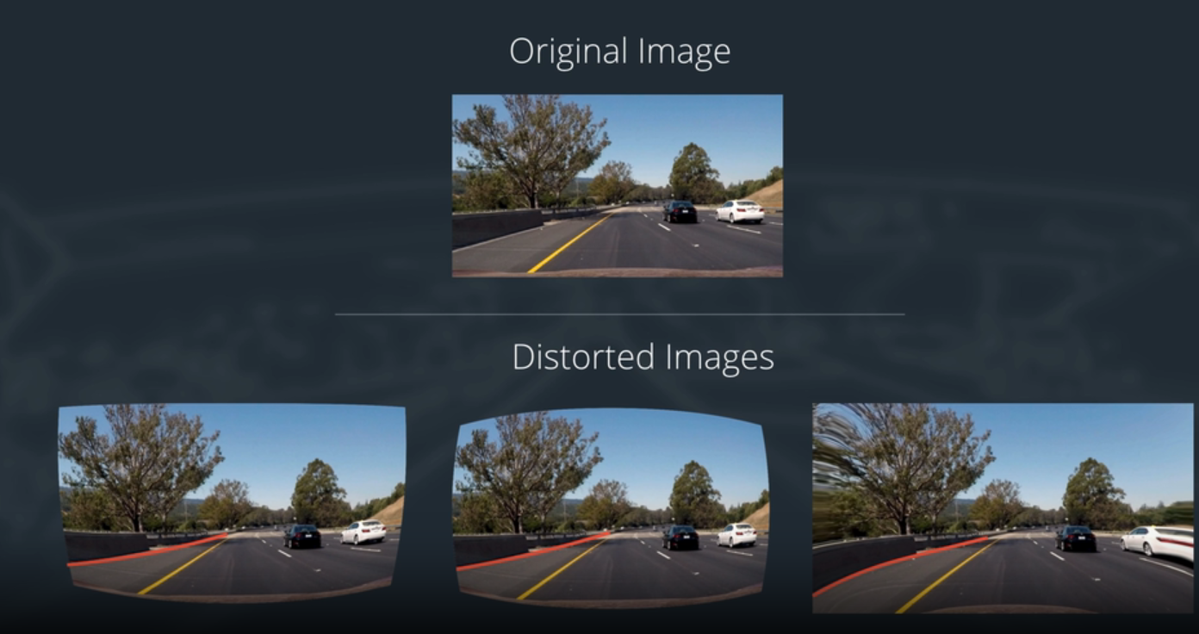
CAMERA DISTORTION CORRECTION
When a camera looks at a 3D object in a real world and converts into a 2D image, this transformation is imperfect. This is called camera Distortion. Because of this distortion, the lanes become curved, which is a problem for Self Driving cars. So, we should undo this so that we can make correct decisions. For example, if the curves are bent, then we cannot know where the lane ends.
Image distortion occurs when a camera looks at 3D objects in the real world and transforms them into a 2D image; this transformation isn’t perfect. Distortion actually changes what the shape and size of these 3D objects appear to be. So, the first step in analyzing camera images, is to undo this distortion so that you can get correct and useful information out of them.

Slide 6
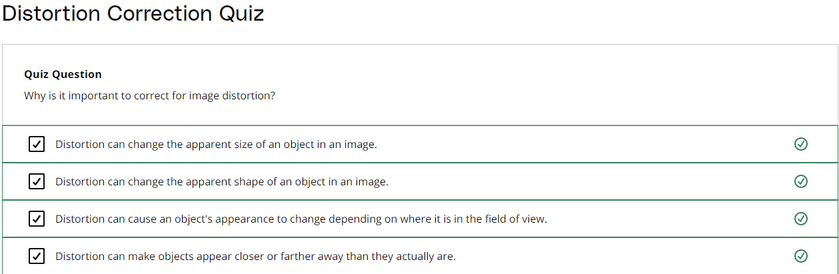

Slide 7
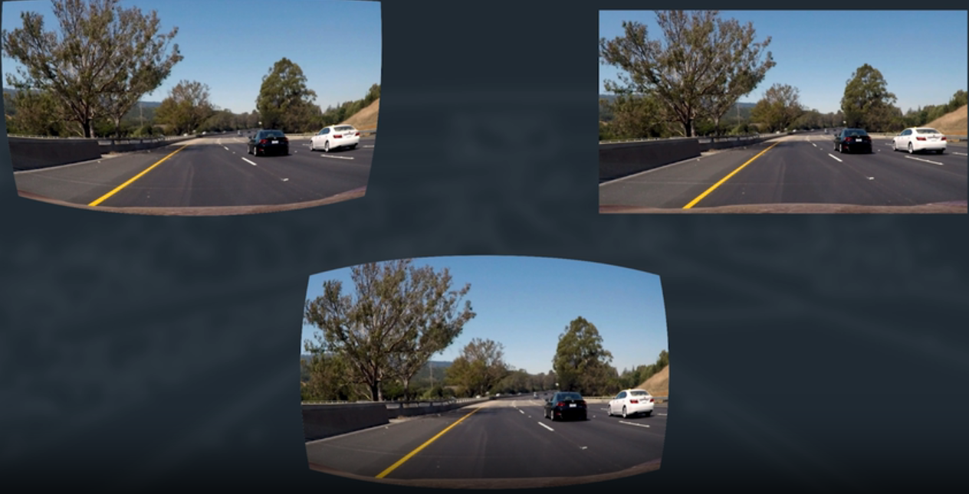
Camera Pinhole Model
Types of Distortion
Real cameras use curved lenses to form an image, and light rays often bend a little too much or too little at the edges of these lenses. This creates an effect that distorts the edges of images, so that lines or objects appear more or less curved than they actually are. This is called radial distortion, and it’s the most common type of distortion.
Another type of distortion, is tangential distortion. This occurs when a camera’s lens is not aligned perfectly parallel to the imaging plane, where the camera film or sensor is. This makes an image look tilted so that some objects appear farther away or closer than they actually are.

Slide 8
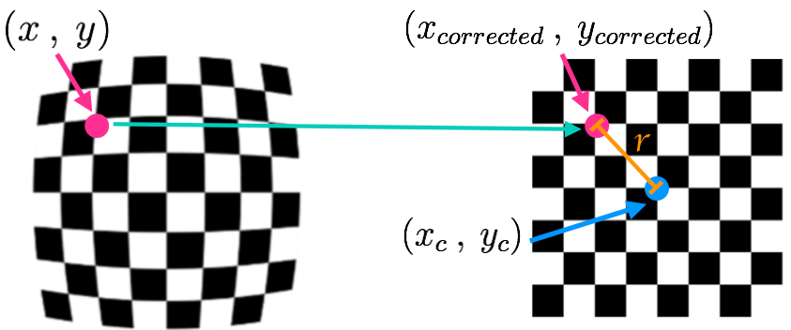
Distortion Coefficients and Correction
There are three coefficients needed to correct for radial distortion: k1, k2, and k3. To correct the appearance of radially distorted points in an image, one can use a correction formula.
In the following equations, (x,y) is a point in a distorted image. To undistort these points, OpenCV calculates r, which is the known distance between a point in an undistorted (corrected) image (xcorrected​, ycorrected​) and the center of the image distortion, which is often the center of that image (xc​,yc​). This center point (xc​,yc​) is sometimes referred to as the distortion center. These points are pictured below.
Note: The distortion coefficient k3 is required to accurately reflect major radial distortion (like in wide angle lenses). However, for minor radial distortion, which most regular camera lenses have, k3 has a value close to or equal to zero and is negligible. So, in OpenCV, you can choose to ignore this coefficient; this is why it appears at the end of the distortion values array: [k1, k2, p1, p2, k3]. In this course, we will use it in all calibration calculations so that our calculations apply to a wider variety of lenses (wider, like wide angle, haha) and can correct for both minor and major radial distortion.
Points in a distorted and undistorted (corrected) image. The point (x, y) is a single point in a distorted image and (x_corrected, y_corrected) is where that point will appear in the undistorted (corrected) image.

Slide 9
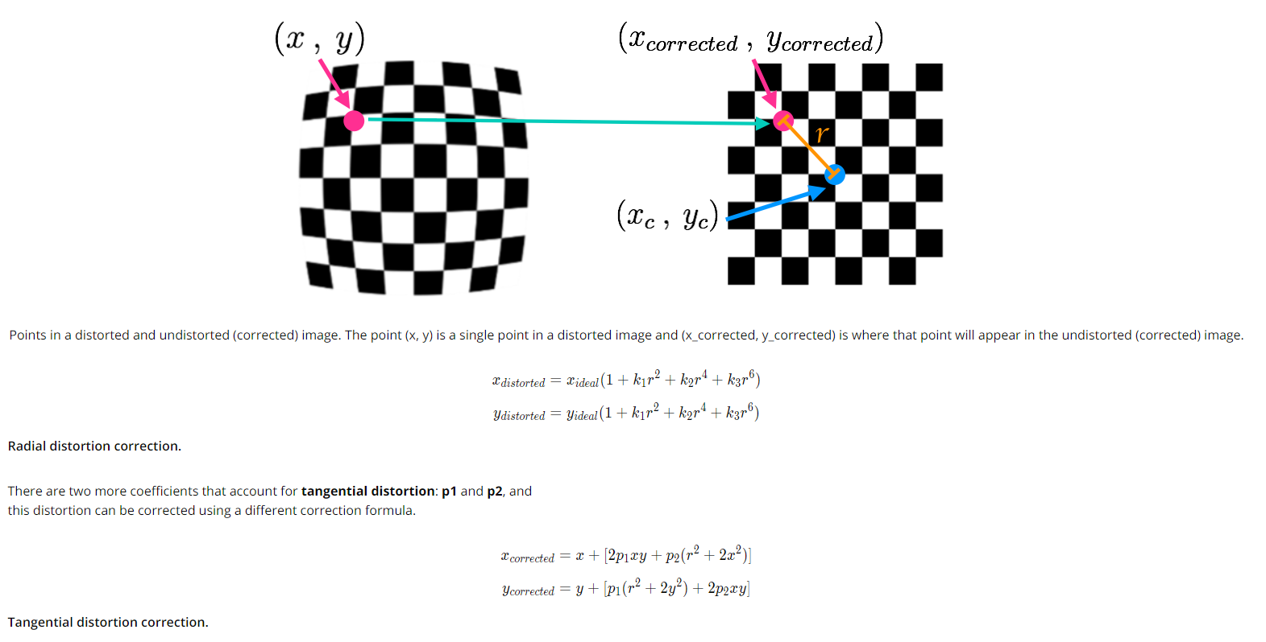

Slide 10
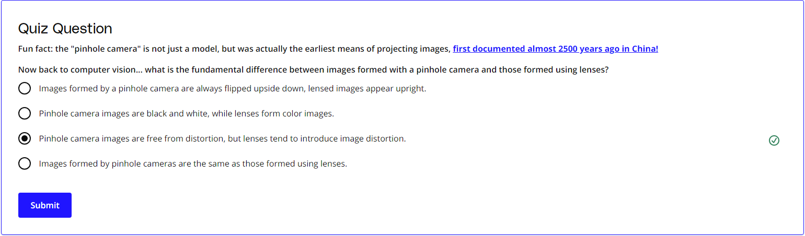

Slide 11
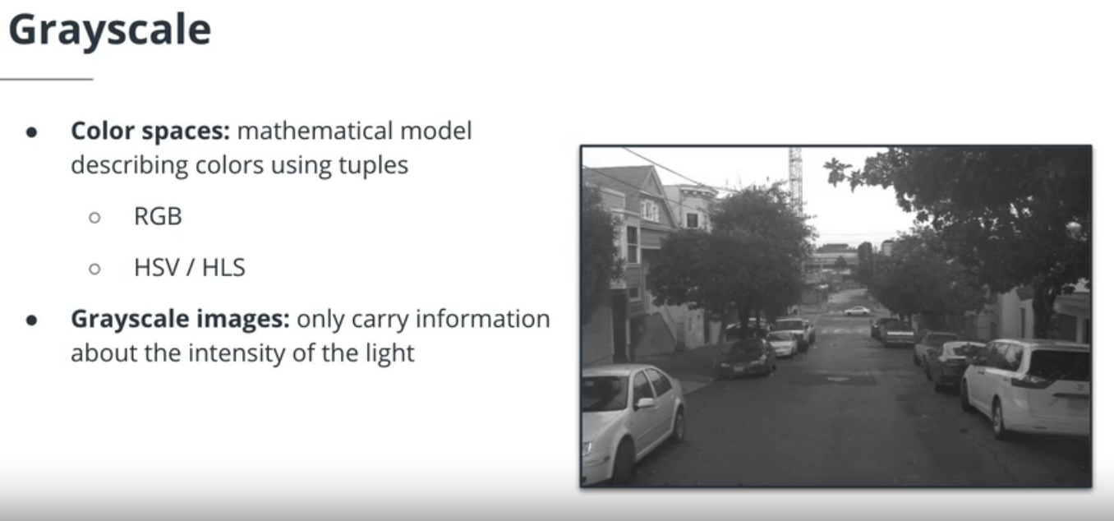
Image Manipulation
In greyscale model, a lot of information is lost.
Grayscale images are single channel images that only contain information about the intensity of the light.
Color models are mathematical models used to describe digital images. The Red, Green, Blue (RGB) color model describes images using three channels. Each pixel in this model is described by a triplet of values, usually 8-bit integers. This is the most common color model used in ML. HLS/HSV are also very popular color models. They take a different approach than the RGB model by encoding the color with a single value, the hue. The other two values characterize the darkness / colorfulness of the image.

Slide 12
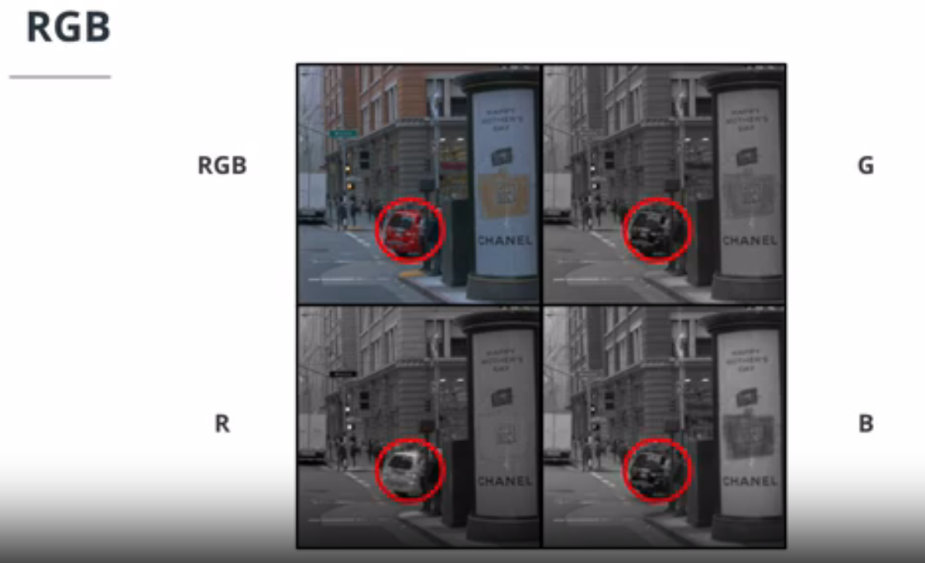
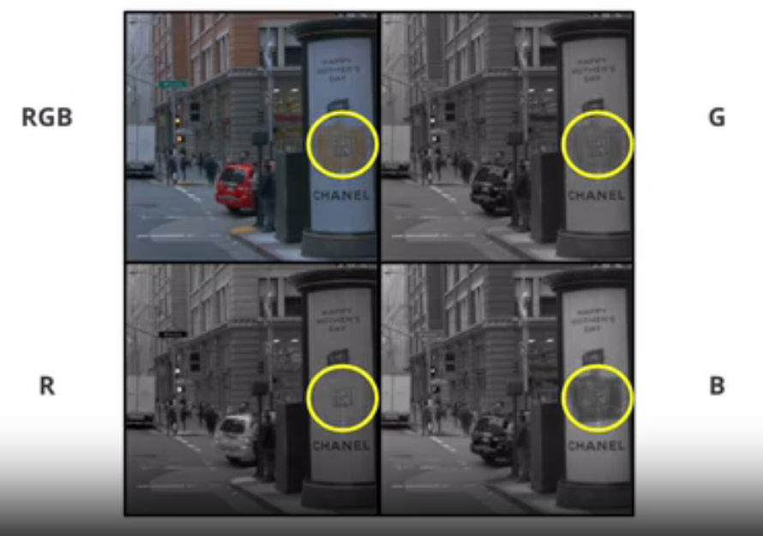
See how the red car looks in different intensity models.
See how the yellow mark looks in different intensity models.

Slide 13
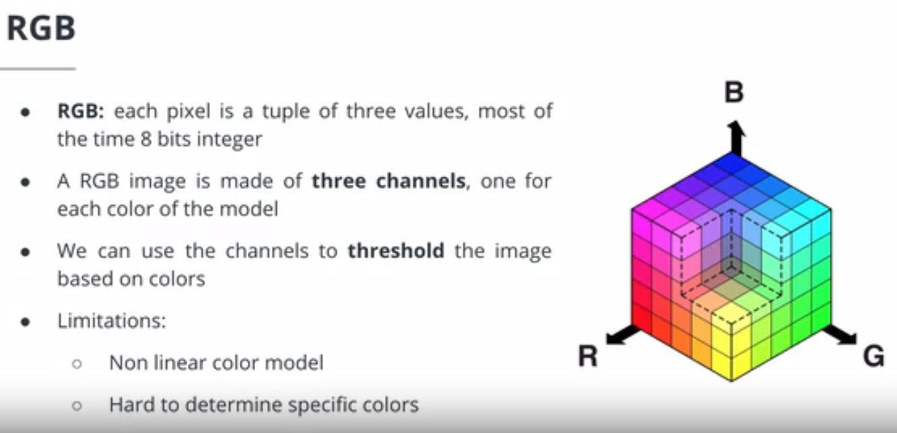

Slide 14
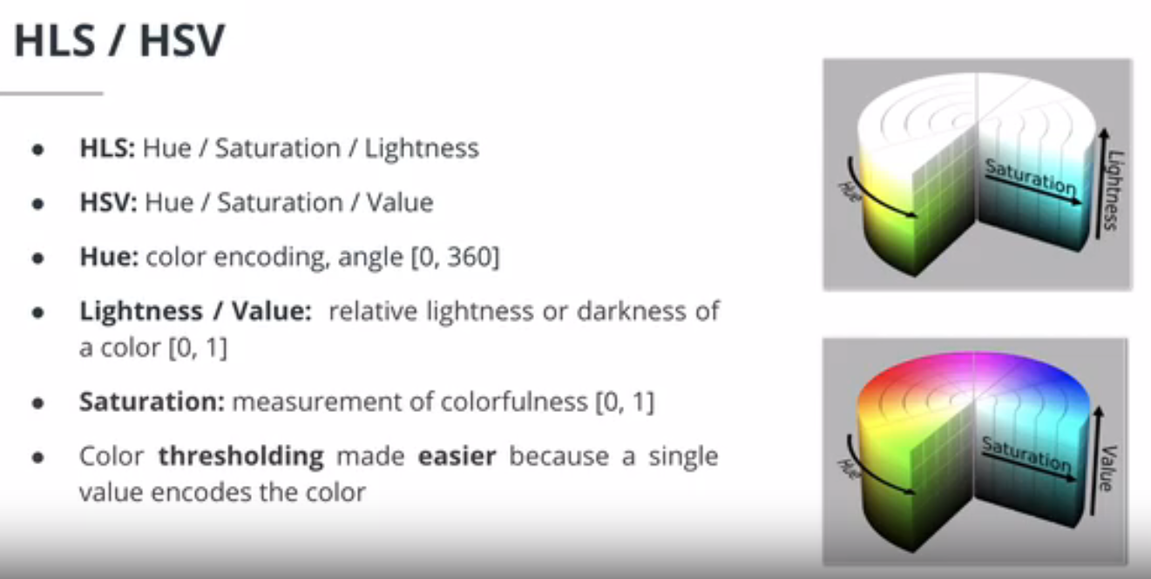
Bright red has high saturation value

Slide 15
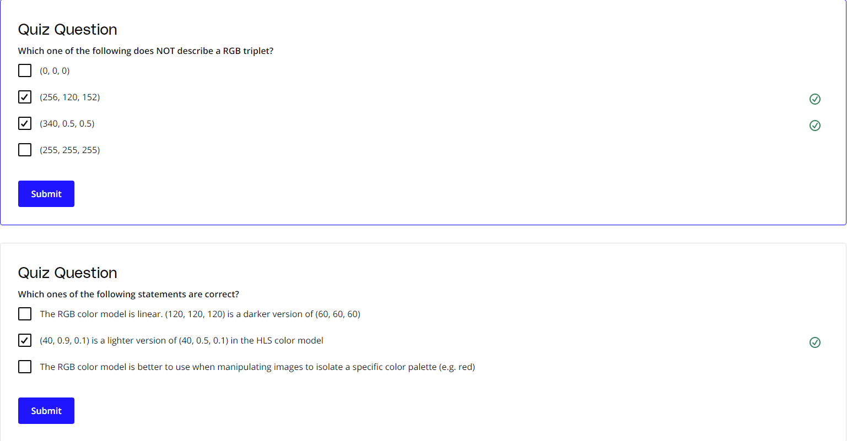
RGB colour models have decimals as well. Each value is from (0 to 255)

Slide 16
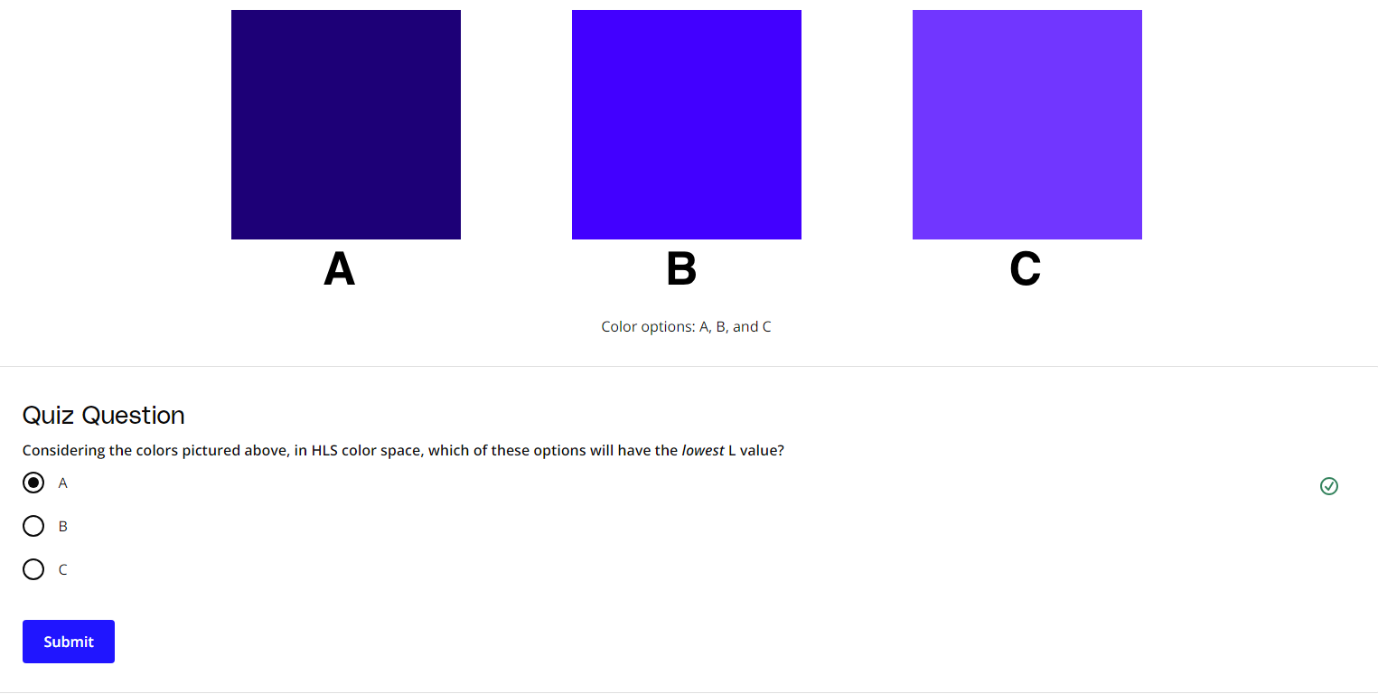
Pixel Level Transformation Quizzes
Lowest L means the darkest colour.

Slide 17

L means light, S means Saturation 8bright red has high saturation value)
With this data, I can say that maybe Hue for them will be same.

Slide 18
Geometric Transformation
1- Resizing of image
Affine transformation is a geometric transformation that preserves lines and parallelism( but not necessarily distances and angles).
2- Translation
3- sheering
4- Combination
In addition to pixel level transformation, Pillow also provides ways to perform geometric transformations, such as rotation, resizing or translation. In particular, we can use Pillow to perform affine transformation (a geometric transformation where lines are preserved) using a transformation matrix.

Slide 19

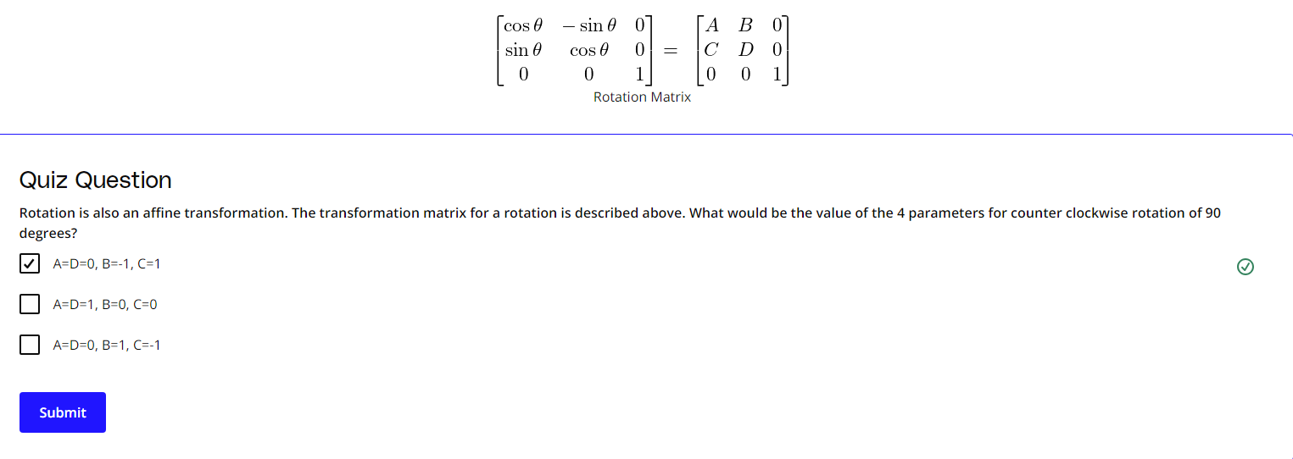

Slide 20
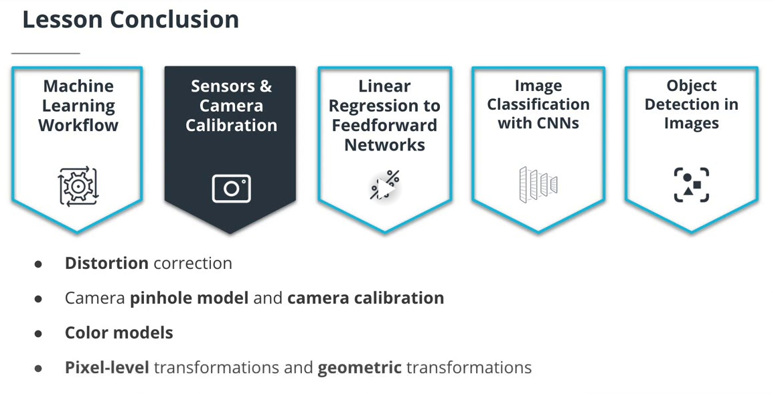
In this lesson, we learned about:
The camera sensor and its distortion effect. A camera captures light to a digital sensor but the raw images are distorted.
The camera pinhole model: a simplified physical model of cameras.
Camera calibration and how to use the Python library OpenCV to calibrate a camera using checkerboard images.
RGB and other color systems. We discovered the RGB, HLS and HSV color systems and learned about the strength and weaknesses of each one.
Image manipulation in Python and how to leverage Pillow to perform pixel-level and geometric transformations of digital images.

Slide 21
Aperture: size of the opening where the light enters the camera. Controls the amount of light received by the sensor.
Calibration: process of estimating a camera's parameters.
Focal length / field of view: this parameter controls the angle of view of the image.
Grayscale images: single channel images that only contain information about the intensity of the light.
HLS/HSV: color model encoding the color with a single value, the hue. The other two values characterize the darkness / colorfulness of the image.
Pinhole camera model: simplified physical model of a camera.
Resolution: Number of pixels the image captured by the camera is made of (usually described in mega pixels).
RGB: color model using (red, green, blue) triplet to describe a pixel.
Shutter speed: duration that the sensor is exposed to the light.

Slide 22
THE END

